Slide 1

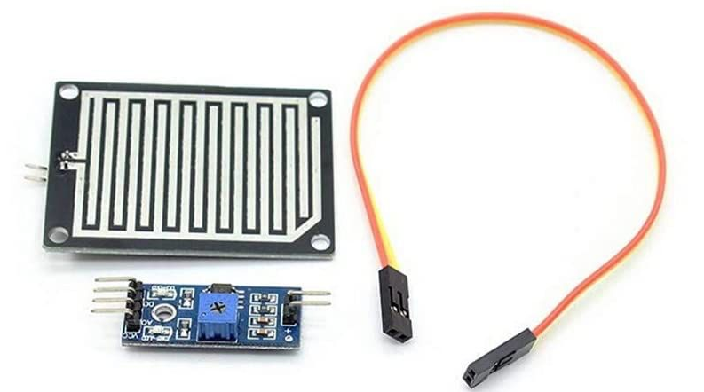
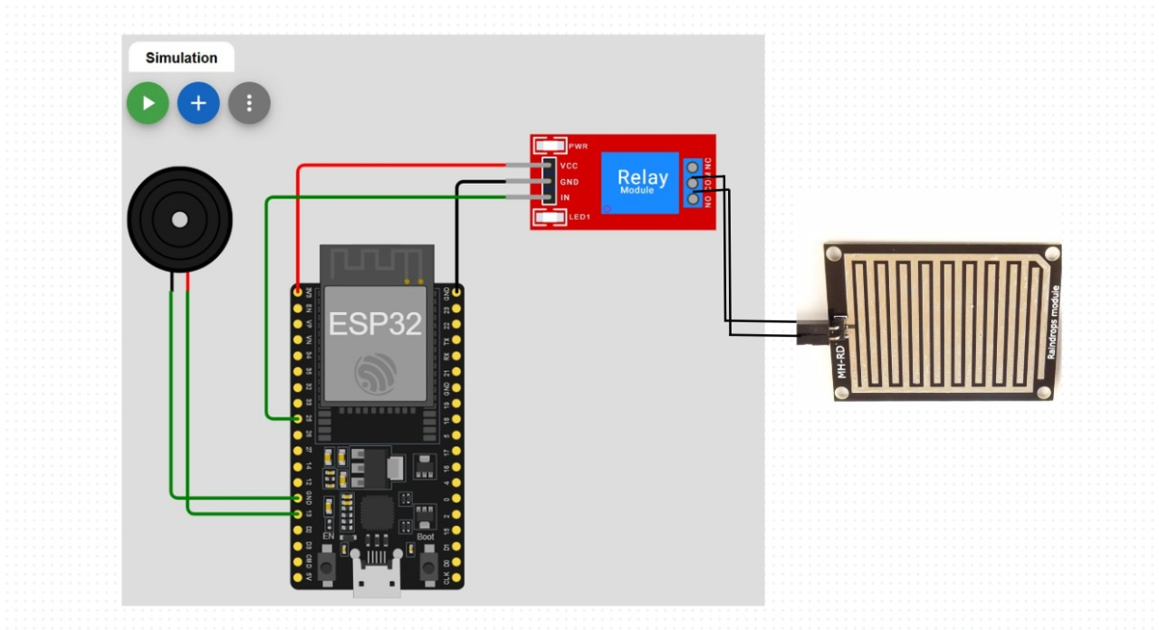
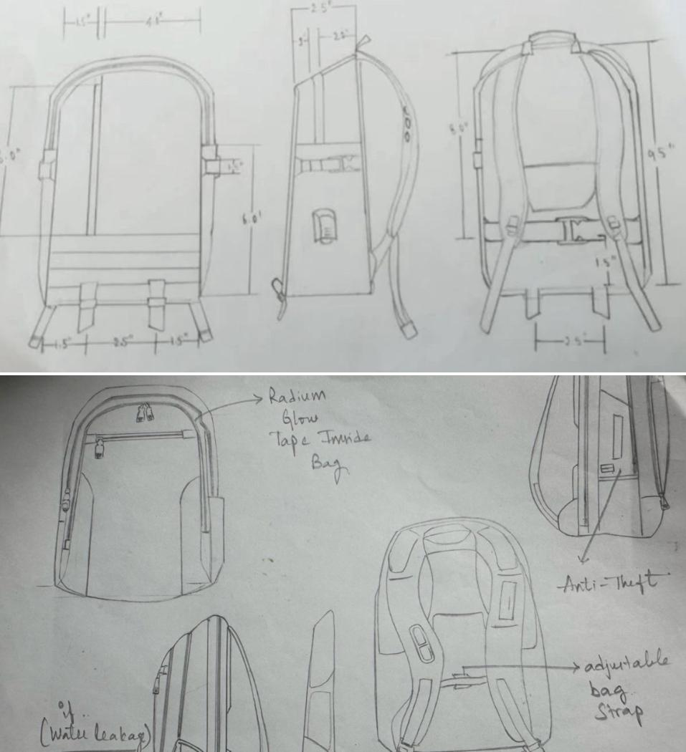

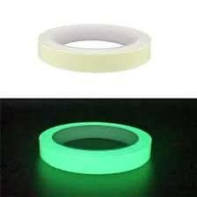
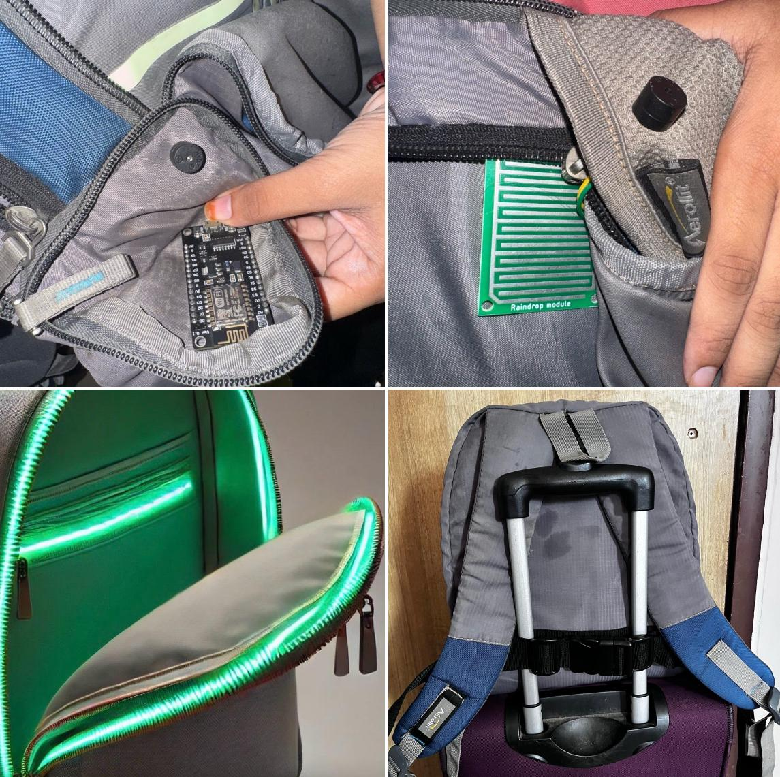
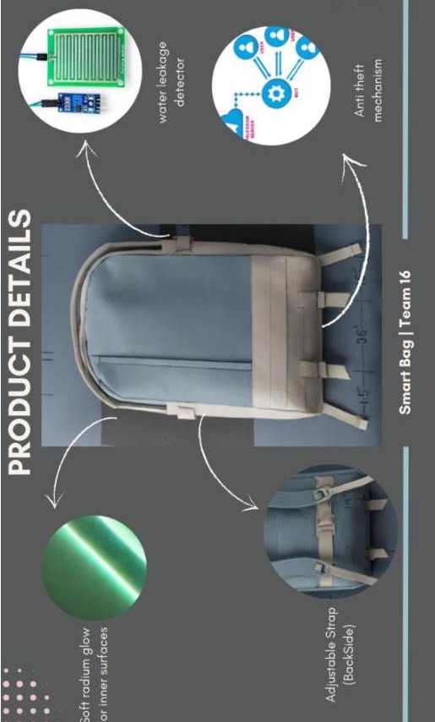


Development of a Smart Bag with Integrated Safety and Comfort Technologies
EC23B1002-G Deavi Asritha , EC23B1011-N Supriya , EC23B1014-Ch Pallavi , EC23B1093-Y Poojitha , EC23B1096-P Jahnavi , EC23I1007-G Oohitha
Dr .Monisha Mohan , Dr. Arunachalam M
Abstract : PROBLEM STATEMENT
We present a Smart bag Designed to integrate four innovative features : Water leakage detection , Anti Theft Protection , Radium glow tape for Visibility , and an adjustable bag Strap for personalized comfort . These features aim to enhance user experience and safety, offering a combination of convenience, security, and smart functionality for daily use.
Keywords : OBJECTIVES
Smart Bag; Water Leakage Detection; Anti-Theft;
Radium Glow Tape; Adjustable Straps
IV. Overview , Specifications and BOM
A) Table for System Component Specifications :
Component | Type | Model / Brand / Cost | Specification & Purpose
Raindrop Sensor | Moisture | Robodo SEN 5 (229/- ) | Detection range : 1mm to 6mm Detects water leakage inside the bag
Wi-Fi Module | Wireless Communication | ESP32 (517/-) ESP8266 (474/-) | Max Range : 100m Connects to user’s phone for alerts
Radium Glow Tape | Light-emitting Material | Custom Phosphorescent (299/-) | Provides visibility in low light
Strap Adjustment | Adjustable Mechanism | Custom Design (200/-) | Load Capacity : up to 10N Distributes weight for user comfort
I. Introduction
This poster presents the development of a smart bag that incorporates cutting-edge technology to address the everyday challenges of security, comfort, and visibility. The bag is equipped with sensors for detecting water leakage and alerts the user via a buzzer application. Anti-theft mechanisms include a built-in locking system alerts the user via a connected mobile application. Radium glow tape enhances visibility in low-light environments, while the adjustable strap ensures ergonomic design tailored to the user's preference.
B) Table of Comparison of Feature :
Feature | Performance Metric | Water Leak” | Anti-Theft | Radium Glow Tape | Adjustable Strap
Detection time | Time to detect problem | 0.5sec | 1 sec | N/A | N/A
Battery Consum” | Power required for operation | Low | Moderate | Low | N/A
User Comfort | Comfort for user during use | N/A | N/A | N/A | High
Visibility in Dark | Effectiv” in dark conditions | N/A | N/A | High | N/A
Range | Operational distance or range | N/A | 100m | N/A | N/A
II. Principle
Describe the basic principle of our project work here.
The scope of the conference includes principally the following topics:
Principle of resistivity changes (Electrical Conductivity)
Analog-to-Digital Conversion
Buzzer Activation
Wireless Communication (- Mobile app Notification)
Electromagnetic Waves in Radio Frequency Spectrum
Principle of phosphorescence
Material Science
Mechanical Design and Adjustment Mechanism (Ergonomics)
Moment of Force
III. System Simulation and Performance Analysis of Smart Bag Features : CONCEPT DESIGN
1.Water Leakage Detection :
Resistance Change in Sensor – The basic principle behind detecting water is that water acts a conductor and changes the resistance of the sensor . If the sensor’s resistance ,R , changes when exposed to water , the relationship can be modeled by :
R=ρ.(L/A)​
When water is detected, the resistance decreases, and this change can trigger an alarm.
2.Anti-Theft Mechanism :
RSSI (Received Signal Strength Indicator) – To model the range of the signal, we use signal attenuation formulas.
Threshold Distance (for alert) – To set a threshold for the anti-theft system, the distance at which the alert is triggered can be determined by the change in signal strength relative to a set threshold value :
RSSI = 10⋅n⋅log(d) + C
Power at distance d : P(d) = P₀ / dⁿ
Where P0 : Reference power at distance d0
n : path loss exponent
the power of the signal decreases with distance and use RSSI to determine when the alert should be triggered.
3.Radium Glow Tape (Phosphorescence) :
Phosphorescence Decay Rate – The glow tape’s light emission can be modeled using an exponential decay function. The intensity of light I(t) at time t is given by :
I(t) = I₀ · e⁻ˡᵗ
This equation shows how the intensity of the glow decreases over time after the material has absorbed light.
4.Adjustable Strap (Load Distribution and Comfort) :
Load Distribution – To calculate how the weight is distributed across the strap, we can use the principle of moment of force.
IV. Circuit Diagram , Sketches , Viscom : PROTOTYPE
(1)
(2)
(3)
V. OUTCOME

